Slide 1
SQL and Components of SQL
Module I

Slide 2
Topics to be covered in Module-I
Introduction to oracle , Defining a database in SQL,
Components of SQL: DDL, DML, DCL, DQL,
SQL query Rules,
Data types, Keywords, Delimiters, Literals.
DDL Commands – Defining a database in SQL, Creating table, changing table definition, removing table. Truncating Table.
DML Commands- Inserting, updating, deleting data,

Slide 3
Introduction to Oracle:
History,
Features,
Versions of Oracle,

Slide 4
What is Oracle
Oracle database is a relational database management system. It is known as Oracle database, OracleDB or simply Oracle. It is produced and marketed by Oracle Corporation..
Oracle database is the first database designed for enterprise grid computing. The enterprise grid computing provides the most flexible and cost effective way to manage information and applications.

Slide 5
History,
Larry Ellison and his two friends and former co-workers, Bob Miner and Ed Oates, started a consultancy called Software Development Laboratories (SDL) in 1977.
SDL developed the original version of the Oracle software. The name Oracle comes from the code-name of a CIA-funded project
Ellison had worked on while previously employed by .

Slide 6
Oracle Database features
Oracle Database allows you to quickly and safely store and retrieve data. Here are the integration benefits of the Oracle Database:
Oracle Database is cross-platform. It can run on various hardware across operating systems including Windows Server, Unix, and various distributions of GNU/Linux.
Oracle Database has its networking stack that allows application from a different platform to communicate with the Oracle Database smoothly. For example, applications running on Windows can connect to the Oracle Database running on Unix.

Slide 7
ACID-compliant – Oracle is ACID-compliant Database that helps maintain data integrity and reliability.
Commitment to open technologies – Oracle is one of the first Database that supported GNU/Linux in the late 1990s before GNU/Linux become a commerce product. It has been supporting this open platform since then.

Slide 8
Oracle Database has several structural features that make it popular:
Logical data structure – Oracle uses the logical data structure to store data so that you can interact with the database without knowing where the data is stored physically.
Partitioning – is a high-performance feature that allows you to divide a large table into different pieces and store each piece across storage devices.
Memory caching – the memory caching architecture allows you to scale up a very large database that still can perform at a high speed.

Slide 9
Data Dictionary is a set of internal tables and views that support administer Oracle Database more effectively.
Backup and recovery – ensure the integrity of the data in case of system failure. Oracle includes a powerful tool called Recovery

Slide 10
Oracle Database Editions
Oracle provides three main editions of Oracle Databases as follows:
1) Enterprise Edition (EE) is the common and expensive edition of the Oracle Database. It has the following characteristics:
No maximum number of CPUs
No limits on memory or database size
Include premium features that are not available in other editions.

Slide 11
2) Standard Edition (SE) is a limited edition of the Enterprise Edition that has the following characteristics:
Limited to four or fewer CPUs
No limit on memory or database size
Include many features, but no as many as EE
3) Expression Edition (XE) is a free-to-use version of the Oracle Database that available on both Windows and GNU/Linux platforms. These are the features of Oracle Database XE 18c:
Limited to 2 CPUs
Can use the maximum of 2GB of RAM, and has 12GB of user data.
Very limited features

Slide 12
Introduction to SQL,
SQL is Structured Query Language, which is a computer language for storing, manipulating and retrieving data stored in a relational database
SQL is a language to operate databases; it includes database creation, deletion, fetching rows, modifying rows, etc. SQL is an ANSI (American National Standards Institute) standard language, but there are many different versions of the SQL language.
SQL is the standard language for Relational Database System. All the Relational Database Management Systems (RDMS) like MySQL, MS Access, Oracle, Sybase, Informix, Postgres and SQL Server use SQL as their standard database language.

Slide 13
Rules for SQL
Sql starts with a verb. E.g. Select statement
Each verb is followed by number of clauses E.g.. From , where , Having.
A space separates clauses E.g. Drop Table EMP.
A semi colon(;)is used to end SQL statements.
A statement may splits across lines but keyword may not.

Slide 14
Rules for SQL
Reserved words can not be used as identifiers unless enclosed with double quotes.
Identifiers contains up to 30 characters and must start with an alphabetic character.
Character and date literals must be enclosed with in single quotes.
Numeric literals can be represented by simple values such as 0.32, -34,09919 so on.
Comment may be enclosed between /* and */ may be multiline.
Single line comments may be prefixed with – symbol.

Slide 15
Rule for naming the tables
Each table must have a unique name.
Name can have maximum of 30 Characters.
Name must begin with an alphabet.
It can have A to Z , 0 -9 ,_(under score).
It can not be a SQL reserve word.
We can use upper and lower case characters because it not a case sensitive (oracle).

Slide 16
Rules for naming Column
With in a table column name must be unique, how ever we may use the same column-name in different table.
It can have maximum of 30 characters .
Column name must begin with alphabet.
A table can have maximum of 254 columns.

Slide 17
Sql Delimiters
A delimiter is a simple or compound symbol that has a special meaning to SQL and PL/SQL.

Slide 18
Sql Delimiters
> | relational operator
@ | remote access indicator
; | statement terminator
- | subtraction/negation operator
:= | assignment operator
=> | association operator
|| | concatenation operator
** | exponentiation operator
<< | label delimiter (begin)
>> | label delimiter (end)
/* | multi-line comment delimiter (begin)
*/ | multi-line comment delimiter (end)
.. | range operator
<> | relational operator
!= | relational operator
~= | relational operator
^= | relational operator
<= | relational operator
>= | relational operator
-- | single-line comment indicator
Symbol | Meaning
+ | addition operator
% | attribute indicator
' | character string delimiter
. | component selector
/ | division operator
( | expression or list delimiter
) | expression or list delimiter
: | host variable indicator
, | item separator
* | multiplication operator
" | quoted identifier delimiter
= | relational operator
< | relational operator

Slide 19
Data Types in oracle
Char(Size):-used to store character string values of fixed length. It can be hold up to 2000 char.(Oracle 10g)
Varchar or Varchar2:- It is used to store variable length of record alpha numeric data up to 4000 char.(oracle 10g)
Number(P,S):-It is used to store numbers fixed or floating. P is total size, S number of Decimal places.
Date :- Used to store date data. The standard date format for date is DD-MM-YY HH:MI:SS.
Long:- used to store variable length character up to 2GB. It can not be indexed or SUBSTR() function can not be applied on Long Data type.
Raw /Long raw:- Used to store Binary data Like image or Pictures
Raw size=255 byte
Long raw=2GB it can not be indexed.

Slide 20
Components of Structured Query Language
SQL is consists of following language
Data Definition Language(DDL)
Data Manipulation Language(DML)
Data Control Language(DCL)
Transaction Control Language(TCL)

Slide 21
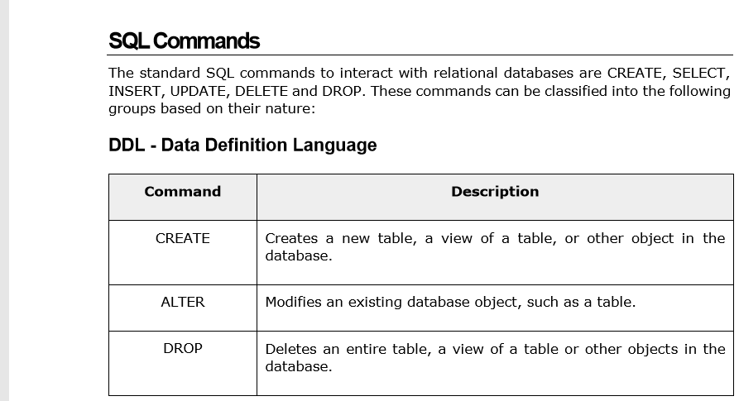

Slide 22
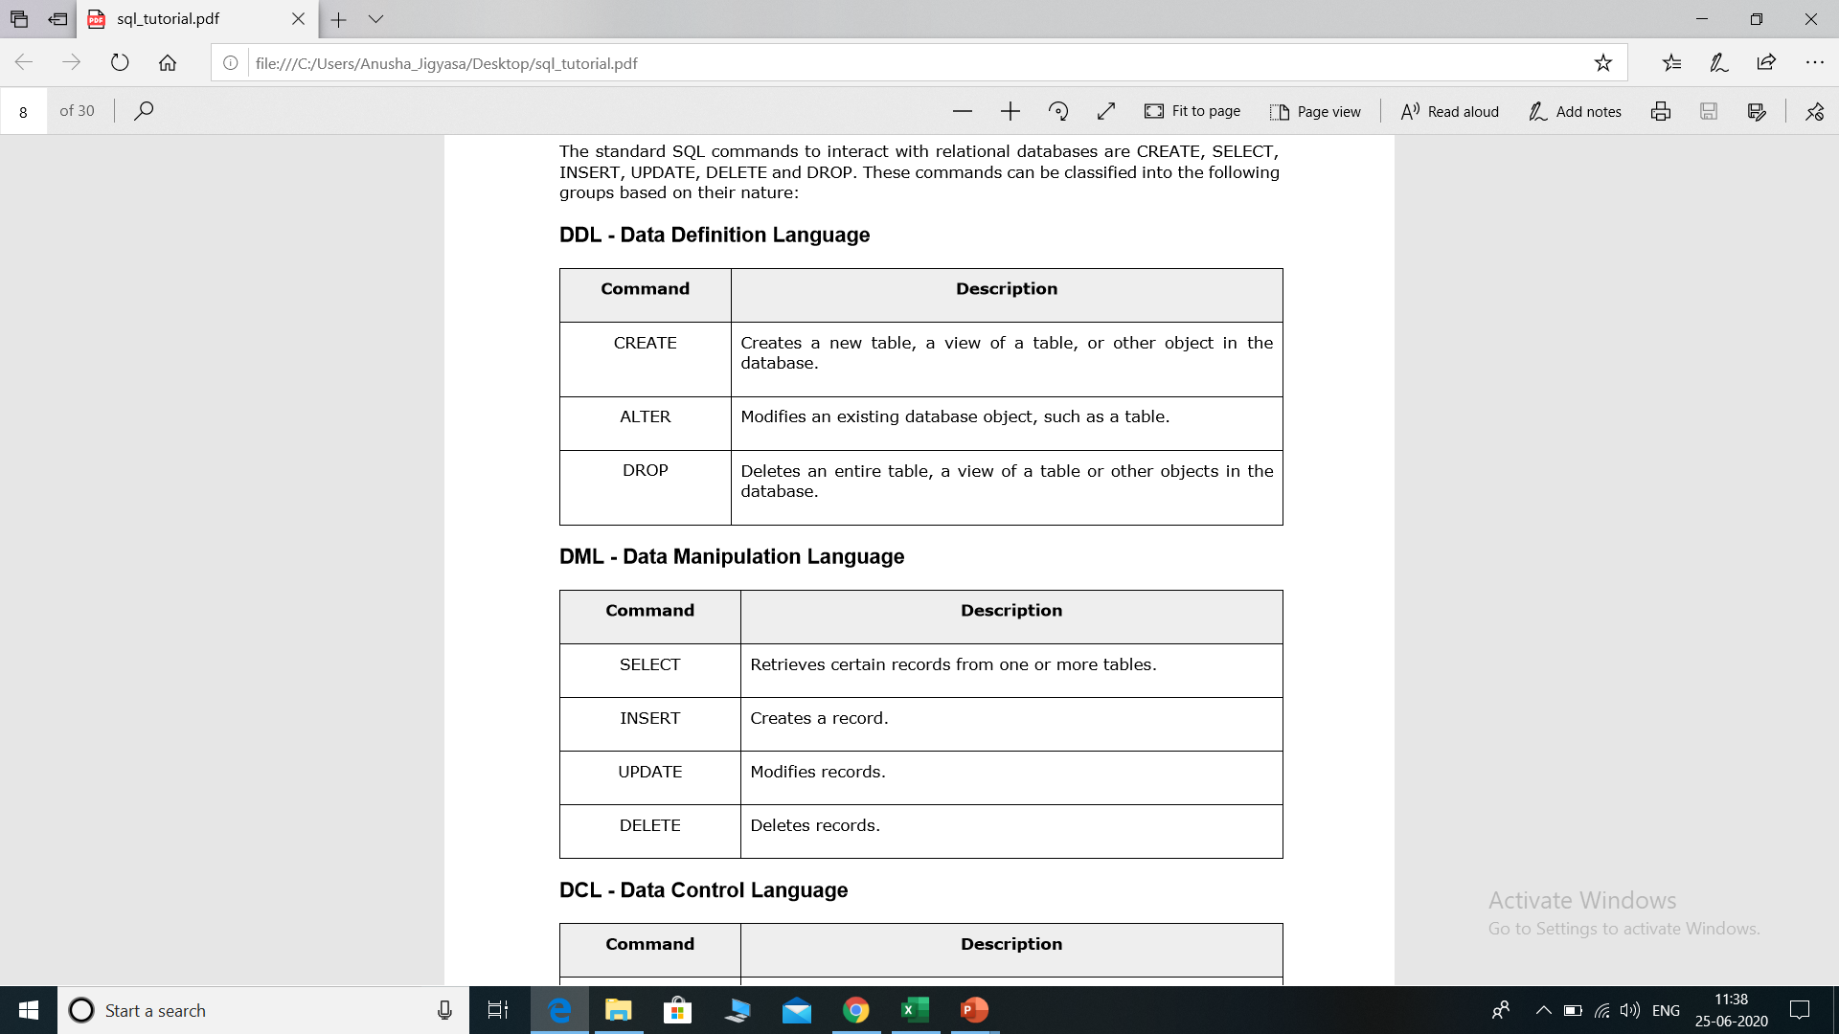

Slide 23
SQL Commands
DCL Commands
GRANT, REVOKE.
TCL Commands
COMMIT ,ROLLBACK, SAVEPOINT.

Slide 24
Select command
It is used to fetch record from table or tables.
syntax
Select coloumn1,column2…….columnN from <table name>.
Example:-
Selection of all row & all columns.
SELECT * FROM EMP;
Column wise selection
SELECT EMPID, ENAME ,SAL, COMM FROM EMP;
Row wise selection
SELECT * FROM EMP WHERE DEPTNO=10;
Row and Column wise selection
SELECT ENAME,JOB, SAL FROM EMP WHERE DEPTNO=10;

Slide 25
Create Command(DDL)
It is used to create table (definition:-column number, data type & size).
Syntax
CREATE TABLE <Table Name>
(Coloumn name1 Datatype(size) ,
Coloumn name2 Datatype(size),
.
.
Column nameN Datatype(size));

Slide 26
Create command examples
Create table Student
(Rollno number(4),
Sname varchar2(20),
Dob Date,
Course Varchar2(15),
Univ Varchar2(15),
Fee Number (15,2));

Slide 27
Alter table command(DDL)
It is used to make any changes in table definition
Such as
Increasing/ decreasing column width.
Can change data type of a column.
Add a column .
Delete a column.
Note:- To decrease a column width the table should not have any data

Slide 28
Syntax of Alter table command
ALTER TABLE <table name>
ADD(new column name data type(size),
new column name data type(size));
ALTER TABLE <table name>
MODIFY(column name new data type(new size));

Slide 29
Alter table Examples
To add a new column gross_salary to emp table.
ALTER TABLE EMP
ADD(gross_salary number(10,2));
Increase the size to gross_salary column to 12,2
ALTER TABLE EMP
MODIFY( gross_salary number(12,2));

Slide 30
Drop command(DDL)
It is used to drop table with data
once you have dropped a table in cant be roll backed
Syntax
DROP TABLE <table name>;
Example
DROP TABLE STUDENT;

Slide 31
Rename Command(DDL)
Used to rename table.
Syntax
RENAME <old table name> TO <new table name>.
Example
RENAME emp to Employee;

Slide 32
Insert Command(DML)
Used to insert data into table.
Syntax
Insert into table name(coloumn name1,coloumn name2…..)values(expression, expression);
Example :-
INSERT INTO EMPLOYEE(EMPID,ENAME,JOB, SAL,COMM,DEPTNO)VALUES(‘E001’,’RAMAN’,’ANALYST’,10000.00,500,10);
`

Slide 33
Update Command(DML)
it is used to update table data.
Syntax
UPDATE <table name>
set column name= expression,
column name= expression
where column name = expression;
Example:- add 1000 to salary of each employee of department no 20.
Update emp
set sal=sal+1000
Where deptno=20;

Slide 34
Delete Command(DML)
It is used to delete record from table conditionally or unconditionally.
Syntax:-
DELETE from <table name>;(unconditional)
Example:-DELETE FROM EMP;
DELETE from <table name>
where column name= expression;(conditional)
Example:-DELETE FROM EMP WHERE DEPTNO=20;

Slide 35
Grant Command
Used to grant power to user.
The syntax for granting privileges on a table is:
GRANT PRIVILEGES ON OBJECT TO USER;
For example, if you wanted to grant select, insert, update, and delete privileges on a table called suppliers to a user name smith, you would execute the following statement:
GRANT SELECT,INSERT,UPDATE,DELETE ON EMP TO SMITH;

Slide 36
Grant Command examples
Example:-You can also use the all keyword to indicate that you wish all permissions to be granted. For example:
GRANT ALL ON EMP TO SMITH;
Example:-If you wanted to grant select access on your table to all users, you could grant the privileges to the public keyword. For example:
GRANT SELECT ON EMP TO PUBLIC;

Slide 37
Revoke Privileges on Tables
Once you have granted privileges, you may need to revoke some or all of these privileges.
To do this, you can execute a revoke command. You can revoke any combination of select, insert, update, delete, references, alter, and index.
The syntax for revoking privileges on a table is:
REVOKE privileges ON object FROM user;

Slide 38
Revoke examples
revoke delete on suppliers from Amit;
After this command Amit wont be able to delete data from Suppliers;
revoke all on suppliers from Amit;
After this Amit wont be able to do any operation on suppliers

Slide 39
Commit Command
Used to make changes permanent .
Syntax:-
COMMIT;
EXAMPLE:-
SQL>UPDATE EMP
SET SAL=SAL+200
WHERE DEPTNO=20;
SQL>ROLLBACK; (Changes wont be permanent.)
SQL>COMMIT; (Changes will be permanent.)

Slide 40
Rollback Command
Used to make Undo all changes after last commit.
Sql > delete from emp where deptno =30;
All record of department no. 30 will be deleted.
Sql>rollback;
All record of department no.30 will be roll backed.

Slide 41
Save point Command
A SAVEPOINT is a marker within a transaction that allows for a partial rollback. As changes are made in a transaction, we can create SAVEPOINTs to mark different points within the transaction.
If we encounter an error, we can rollback to a SAVEPOINT or all the way back to the beginning of the transaction.
.

Slide 42
Save point Examples
SQL>savepoint A;
Sql>delete from emp where deptno=10;
sql>Savepoint B;
Sql> delete from emp where deptno=20;
sql> rollback to savepoint B;
sql>update emp set sal=sal+2000 where deptno=10;
sql> savepoint C;
sql>delete from emp;
sql>rollback to savepoint C;

Slide 43
Topics to be covered in Module-II
DQL Commands: Select Statement with all options.
Renaming table, Describe Command, Distinct Clause,
Sorting Data in a Table,
Creating table from a table,
Inserting data from other table,
Table alias, and Column alias.
Data Constraints: Primary key, Foreign Key, NOT NULL, UNIQUE, CHECK constraint

Slide 44
Where clause
Where clause is used to restrict raw by putting condition in select or insert or update or delete or create command.
Select * from emp where deptno=20;
update emp set sal= sal+200 where job=‘ANALYST’;
Order by clause
It is used get record sorted order on any column field
either ASCENDING or DESCENDING
SELECT ENAME,SAL ,COMM FROM EMP ORDERBY ENAME ASC.
SELECT ENAME,SAL ,COMM FROM EMP ORDERBY ENAME DESC.

Slide 45
Creating table from a table,
Syntax create table<tableName>(<columnName>,<ColumnName>) as select<columnName>,<columnName> from <TableName>
Create table acct_dtls(acct_no,Branch_no,balance)as select acct_no, branch_no, curbal from acct_mstr;

Slide 46
Inserting data from other table,
Syntax:
Insert into <tableName> select<columnname1>,columnName N from <tableName>;
Insert into acct_detls select acct_no, branch_no ,currbal from acct_mstr;

Slide 47
Eliminating Duplicate rows using a select statement
Syntax:
Select distinct <ColumnName1>,<columnName2> from <tableName>;
Select deptno from dept;
Select job from emp;
Select distinct deptno from dept;
Select distinct job from emp;

Slide 48
Data constraints in oracle

Slide 49
Type of Data Constraints
Primary key
Foreign Key
Unique
Not Null
Check

Slide 50
What is a primary key?
A primary key is a single field or combination of fields that uniquely defines a record. None of the fields that are part of the primary key can contain a null value. A table can have only one primary key.
Note:
In Oracle, a primary key can not contain more than 32 columns.
A primary key can be defined in either a CREATE TABLE statement or an ALTER TABLE statement.

Slide 51
How to add PK using create table
The Syntax
CREATE TABLE table_name
(column1 data type (size) null/not null,
column2 data type(size) null/not null,
CONSTRAINT constraint_name PRIMARY KEY (column1, column2, . Column n));

Slide 52
Example
CREATE TABLE supplier
( supplier_id numeric(10) not null, supplier_name varchar2(50) not null, contact_name varchar2(50),
CONSTRAINT supplier_pk PRIMARY KEY
(supplier_id, supplier_name) );

Slide 53
Using an ALTER TABLE statement
Syntax:
ALTER TABLE table_name
add CONSTRAINTconstraint_name PRIMARY KEY (column1, column2, ... column_n);
Example
ALTER TABLE supplier add CONSTRAINT supplier_pk PRIMARY KEY (supplier_id);

Slide 54
Creating more than one primary key with alter table
ALTER TABLE supplier ADD CONSTRAINT supplier_pk
PRIMARY KEY (supplier_id,
supplier_name);

Slide 55
Dropping primary key
Syntax:
ALTER TABLE table_name drop CONSTRAINT constraint_name;
Example:
ALTER TABLE supplier Drop CONSTRAINT supplier_pk;

Slide 56
How to Disable a Primary Key
Syntax
ALTER TABLE table_name disable CONSTRAINT constraint_name;
Example:
ALTER TABLE supplier disable CONSTRAINT supplier_pk;

Slide 57
How to enable primary key
Syntax:
ALTER TABLE table_name enable CONSTRAINT constraint_name;
Example:
ALTER TABLE supplier enable CONSTRAINT supplier_pk;

Slide 58
Foreign key

Slide 59
What is a foreign key?
A foreign key means that values in one table must also appear in another table.
The referenced table is called the parent table while the table with the foreign key is called the child table. The foreign key in the child table will generally reference a primary key in the parent table.

Slide 60
Creating Foreign Keys:
Foreign Keys
Foreign Keys with cascade delete
Foreign Keys with "set null on delete"
Dropping Foreign Keys:
Drop a foreign key
Disable/Enable Foreign Keys:
Disable a foreign key
Enable a foreign key

Slide 61
Adding foreign key with create table
CREATE TABLE table_name (column1 datatype null/not null, column2 datatype null/not null, CONSTRAINT fk_column FOREIGN KEY (column1, column2, ... column_n) REFERENCES parent_table (column1, column2, ...column_n));
CREATE TABLE supplier
( supplier_id numeric(10) not null,
supplier_name varchar2(50) not null,
contact_name varchar2(50),
CONSTRAINT supplier_pk PRIMARY KEY (supplier_id) );

Slide 62
How to create fk with alter table
syntax
ALTER TABLE table_name ADD CONSTRAINT constraint_name FOREIGN KEY (column1, column2, ... column_n) REFERENCES parent_table (column1, column2, …column_n);
Example:
ALTER TABLE products
Add CONSTRAINT fk_supplier FOREIGN KEY (supplier_id) REFERENCES supplier(supplier_id);

Slide 63
We could also create a foreign key with more than one field as in the example below:
ALTER TABLE products
ADD CONSTRAINT fk_supplier
FOREIGN KEY (supplier_id, supplier_name)
REFERENCES supplier(supplier_id, supplier_name);

Slide 64
How to Drop a foreign key
CREATE TABLE products
( product_id numeric(10) not null,
supplier_id numeric(10) not null,
CONSTRAINT fk_supplier FOREIGN KEY (supplier_id) REFERENCES supplier (supplier_id) );
ALTER TABLE table_name Drop CONSTRAINT constraint_name;

Slide 65
How to Drop a foreign key
ALTER TABLE products drop CONSTRAINT fk_supplier;

Slide 66
How to disable fk
ALTER TABLE products disable CONSTRAINT fk_supplier;
ALTER TABLE products enable CONSTRAINT fk_supplier;
How To Enable Fk

Slide 67
Check Constraints
A check constraint allows you to specify a condition on each row in a table.
NOTE:-
Check constraint can NOT be defined on a view.
The check constraint defined on a table must refer to only columns in that table. It can not refer to columns in other tables.
A check constraint can not include a SUBQUERY
A check constraint can be defined in either a create table statement or an alter table Stmnt.

Slide 68
Add check with create table
CREATE TABLE suppliers
( supplier_id numeric(4),
supplier_name varchar2(50),
CONSTRAINT check_supplier_id
CHECK (supplier_id BETWEEN 100 and 9999) );

Slide 69
Example of check for ensuring upper case entries
CREATE TABLE suppliers
( supplier_id numeric(4),
supplier_name varchar2(50),
CONSTRAINT check_supplier_name
CHECK (supplier_name =upper(supplier_name)) );

Slide 70
Adding check with alter table
ALTER TABLE suppliers add CONSTRAINT check_supplier_name CHECK (supplier_name IN ('IBM', 'Microsoft', 'NVIDIA'));

Slide 71
Droping, enabling & disabling check
Dropping
ALTER TABLE suppliers drop CONSTRAINT check_supplier_id;
Enabling
ALTER TABLE suppliers enable CONSTRAINT check_supplier_id;
Disabling
ALTER TABLE suppliers disable CONSTRAINT check_supplier_id;

Slide 72
The syntax to ALIAS A COLUMN in Oracle/PLSQL is:
SQL Aliases are defined for columns and tables. Basically aliases is created to make the column selected more readable.
For Example: To select the first name of all the students, the query would be like:
Aliases for columns:
SELECT first_name AS Name FROM student_details;

Slide 73
Aliases for tables:
SELECT s.first_name FROM student_details s;

Slide 74
Aliases is more useful when
There are more than one tables involved in a query,
Functions are used in the query,
The column names are big or not readable,
More than one columns are combined together

